Slide 1
Table Of Content
In this post you will learn, how to create your table of contents.

Slide 2
What Is The Table Of Content?
“The table of contents is the thesis page that is dedicated to the chapters and their respective page numbers.”

Slide 3
What Is The Table Of Content?
The headings and subheadings are also mentioned on the page. The formatting for this page should be consistent and clear.
The table of contents is added after the introduction page and before the abstract. The table of contents should be of two pages, not more than that.

Slide 4
What should be included in table of content?
The table of content is an organized list that provides basic knowledge of what your thesis contains. The names of the chapters along with subheadings are added on the left side of the page. Whereas the number of the pages is written on the right side.

Slide 5
What should be included in table of content?
Let us look into the general format of a table of content. The chapters(first level) and their second-level headings should be added to this. Remember, your motive behind creating this page is to make it easy for the reader to locate your chapters.

Slide 6
What should be included in table of content?
For example:
Level one heading - Chapter 2. Literature Review
Level two heading -2.1 Research Gap

Slide 7
Appendices and tables
The table of contents must include your appendices and table of figures. If you have more than three and four figures and tables, then they deserve their chapter. But if you don’t get a lot of results from research, then those tables and figures can be shared in the list of contents.

Slide 8
Appendices and tables
Now the question arises, what does the appendices chapter include?
1. The original interviews, surveys, and questionnaires that were used to collect data for the research
.

Slide 9
Appendices and tables
2. Not more than two figures and tables should be added to
the table of content.
3. If did not use a lot of abbreviations then you should share them in the table of content. But if you have tons of abbreviations and technical terms, then they should be listed in their chapters.

Slide 10
Do’s & Donts

Slide 11
The general format of table of contents
The chapters should be numbered with level one heading. And the subheading should be numbered, as demonstrated in example.
Make sure to number the pages accurately.

Slide 12
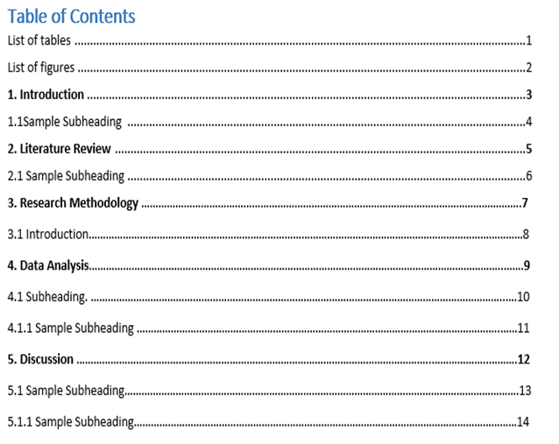
The General
Format Of Table
Of Contents

Slide 13
The Proper Way To Number Your Pages With The Chapters
The page numbers assigned to the chapters in the table of contents should be the same as the number assigned at the beginning of each chapter.

Slide 14
The Proper Way To Number Your Pages With The Chapters

Slide 15
Checklist for the table of contents
Collect the relevant information about the format according to your university and referencing style.
Start with the list of tables and bold the main chapters.

Slide 16
Checklist for the table of contents
All the titles of the chapter should be level one heading and the subheading should be level two.
The numbers of the chapters and the page numbers given in the table should tally.
All pages should be numbered after the chapters are written.

