Slide 1
List of Figures and Tables in the Thesis
Some Essentials to Know

Slide 2
Significance of the list of
figures and tables :
It navigates all the figures and tables used in the thesis
It is required when several figures and tables are used

Slide 3
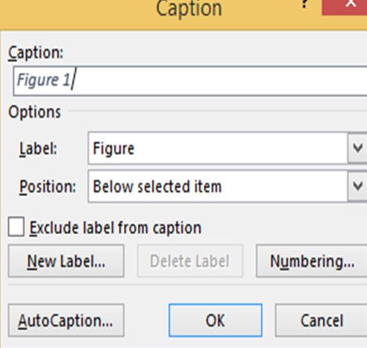
How To Insert Caption
With A Figure?
Left click on the figure
Select the Insert Caption Option (a dialogue box will appear as shown in the picture)
Write a specified title next to the figure in the caption box.

Slide 4
How To Insert Caption
With A Figure?
Note: The word ‘Figure’ is known as a label. You can replace it with ‘image’ or ‘picture’ or any other word that you consider would be suitable. If you don’t want a label before the title of the image so you may exclude it from the caption

Slide 5
Title Of The Figures Should Be
Appropriate:

Slide 6
Page Number Should Be Correctly Written
In this way, the checker can easily locate the page number after going through the list of figures and tables

Slide 7
How to Generate Lists Automatically?
Open the insert table and figures option and you’ll see a dialogue box on your screen.
If you have perfectly inserted the captions and the numbers then the list would be fine.

Slide 8
How to Generate Lists Automatically?
In the menu, bar Word gives you the option of references. By going into this option you will further find an option with the title ‘Insert Table and Figures’
If you have perfectly inserted the captions and the numbers then the list would be fine.

Slide 9
How to Generate Lists Automatically?
In the menu, bar Word gives you the option of references. By going into this option you will further find an option with the title ‘Insert Table and Figures’
If you have perfectly inserted the captions and the numbers then the list would be fine.
Check the web preview

Slide 10
Checklist for List of Tables
Your list of tables should be well formatted
Mention all tables except those that are particular to another list
All titles/captions should be accurate and relatable
Page numbers are clear and correct

Slide 11
Checklist for List of Tables
Your list of tables should be well formatted
Mention all tables except those that are particular to another list
All titles/captions should be accurate and relatable
Page numbers are clear and correct

Slide 12
What to Apply and What to Avoid?
Do’s | Don’ts
Justified format with the right alignment of page numbers. | Change the title to a new one that differs from the actual caption
Using Labels | Using Bullets
Use Simple fonts | Enlarge headings and use multiple fonts
Use a single color for the entire list | Use different colors
Use straight writing | Use bold, italic, underline

Slide 13
THANK YOU

